Slide 1


Billing Process
Plug-ins Involved

Slide 2
What is it?
The billing process is a batch process that generates invoices…
Invoices
Orders
…it might be the most important batch process of a billing system.

Slide 3
Overview
Trigger
Process Company
Process Users
Process Order and Invoices
Generate Invoices

Slide 4
Steps
Summary
For each Company
Invoices
For each Customer
Reviews the billing process configuration:
Next run date
Review Report required, approved?
For each Order
Check if it needs to be billed
Generate invoices
Process payments
Notify
Check if the order should be included for the period being billed.
Determine the periods to invoice

Slide 5
Steps - Transaction
Each step is isolated
Transactions allow for a customer to fail, without the whole process failing.
Each step is wrapped in a transaction
This means we are using ‘nested’ transactions
Code Example
try {
…Process a user…
} catch (Throwable e) {
LOG.error("Exception caught when processing the user " + userId, e);
TransactionAspectSupport.currentTransactionStatus().setRollbackOnly(); // rollback!
return null; // the user was not processed
}

Slide 6
Overview
Trigger
Process Company
Process Users
Process Order and Invoices
Generate Invoices

Slide 7
Steps - Trigger
We have a Scheduled Task that can be configured to be triggered at a specific time and repeated in an interval.
BillingProcessTask.java
We can override the setting to turn it off in the jbilling.properties file using this property process.run_billing=false

Slide 8
Overview
Trigger
Process Company
Process Users
Process Order and Invoices
Generate Invoices

Slide 9
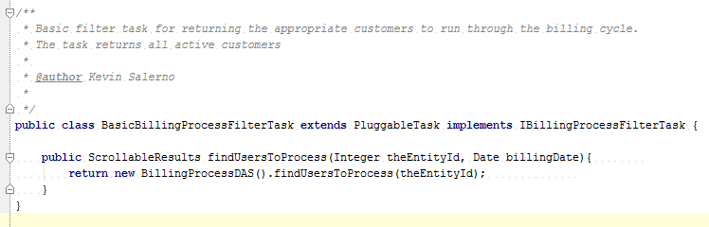

Steps – Process Company
For each company…
We check the “Next Run Date”.
Check if a “Process Review” is needed.
Find applicable customers.
If a Billing Process is necessary for the company, then we need to find all the applicable customers. This is done with a Plug-in…

Slide 10
Overview
Trigger
Process Company
Process Users
Process Order and Invoices
Generate Invoices

Slide 11
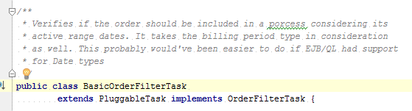

Steps – Process Users
For each customer…
Find all the orders
Evaluate that the order has ‘billable time’
For this we use a Plug-in…
OrderFilterAnticipatedTask

Slide 12
Overview
Trigger
Process Company
Process Users
Process Order and Invoices
Generate Invoices

Slide 13
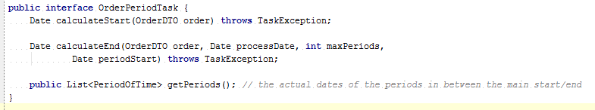

Steps – Process Orders and Invoices
For each order…
Find which periods needs to be invoiced
For this we use a Plug-in…
OrderPeriodAnticipateTask
ProRateOrderPeriodTask

Slide 14
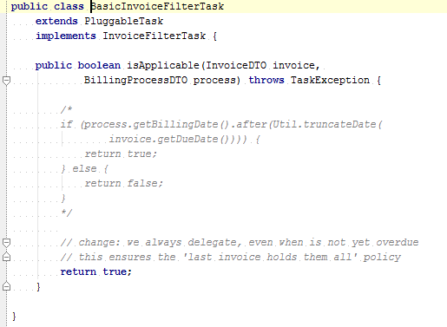

Steps – Process Orders and Invoices
Overdue Invoices…
Invoices that are overdue and not paid might need to get into the latest invoice as well.
For this we use a Plug-in…
NegativeBalanceInvoiceFilterTask
NoInvoiceFilterTask

Slide 15
Overview
Trigger
Process Company
Process Users
Process Order and Invoices
Generate Invoices

Slide 16
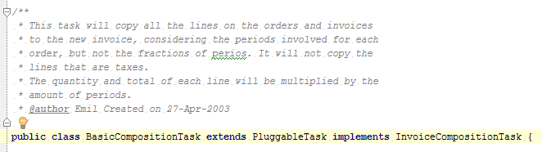

Steps – Generate Invoices
Take the orders and generate them into invoices…
Once we have all the orders and invoices for a customer, we are ready to generate an invoice
The invoice is composed by basically ‘copying’ lines from the orders into it.
A plug-in takes care of this
This is a common spot to ‘slide’ extra lines into invoices… example: Sales Tax (VAT)
For this we use a Plug-in…

Slide 18
!Thank you!

